Slide 1
Healthy India, Wealthy India
Chinmay Sawant

Slide 2
Dataset(s)
World Development Indicators Dataset

Slide 3
Motivation
Health is a key component of individual and social wellbeing. On the healthcare front, things don’t look too good for India. The investment in healthcare is inadequate.
The country’s healthcare system is characterised by inadequate infrastructure and limited resources.
Global evidence on health spending shows that unless a country spends at least 5-6% of its GDP on health, basic healthcare needs are seldom met.
Furthermore, the health of a population is a key driver of labour and capital investment and consequent economic growth.

Slide 4
Research Question(s)
What effects the health status of the population have had on the economic growth of India? Does increase in health investment have lead to faster economic growth?

Slide 5
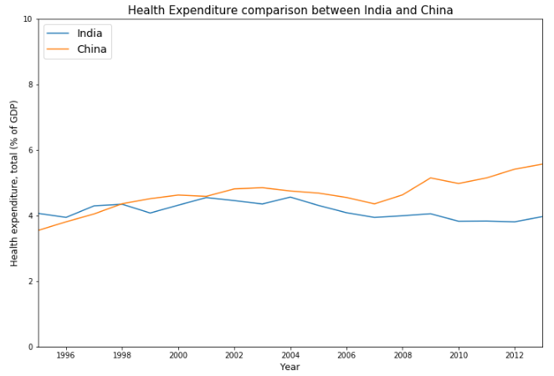
Findings
In 1995, India's health expenditure(% of GDP) was 4.06% compared to China's 3.5% but India's health expenditure have rather decreased over the years with 3.9% of GDP in 2013 compared to China's 5.56%.
Correlation value of 0.95 between the Health expenditure and Life expectancy clearly suggests increase in health expenditure have lead to proportional increase in the life expectancy in India in the past.

Slide 6
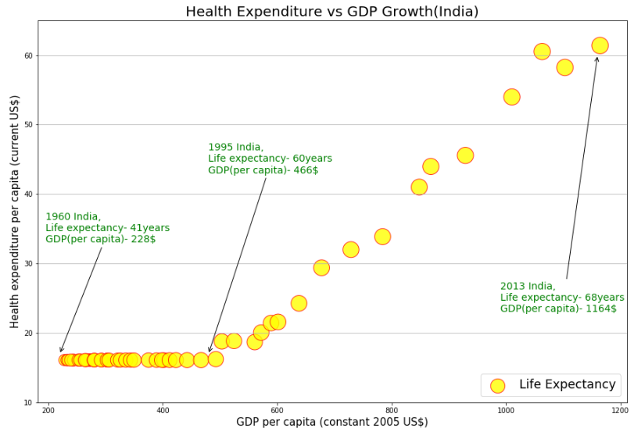
Findings
Above scatterplot clearly shows the correlation between the Health expenditure and GDP growth of India with slight increase in the size of the bubbles suggesting the steady increase in Life expectancy over the years.

Slide 7
Findings
In 1960 with health expenditure less than $60 per capita and life expectancy of 41 year, India had a low GDP per capita of $228.
Minimal increase in health expenditure for next three decades clearly reflects in the slow growth in the GDP with $466 GDP per capita in 1995.
In next three decades with bit more importance towards health-care, health expenditure per capita increased from $18 to $61 leading to a substantial growth in GDP with $1164 GDP per capita in 2013.

Slide 8
Additional Findings
Low public spending in the health care sector is another concern for India.Only 29% of the total health expenditure was funded by public funds in 2011.
Over dependency on private investments in health care will in turn affect the access to health care for the poorer, with 22% of the population below poverty line.
Conclusion
Good health can lead to higher gross domestic product (GDP) per capita in the long run due to its impact on health of labour force leading to more participation, and productivity.

Slide 9
Acknowledgements
No feedback from the peer.

Slide 10
References
No references.

